Slide 1
Labtech Ltd.
PC-Based ECG Systems

Slide 2
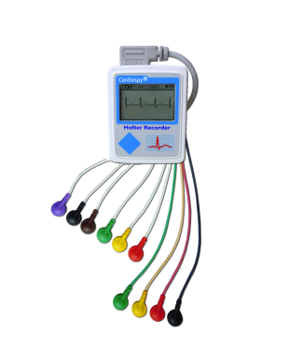
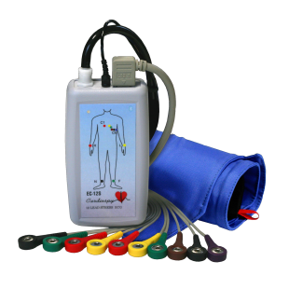
PC Based ECG Systems
Holter Systems
Rest and Stress Systems
NetECG Systems

Slide 3
Holter Systems
New Holter ECG Recorder
1, 2, 3 independent channels or 12-CH ECG
Wireless (Bluetooth®) communication
Integrated 3D motion detection
EC-1H, EC-2H, EC-3H, EC-12H
Pacemaker Detection
Low Power Consumption
Greyscale LCD

Slide 4
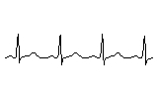
Holter Systems
New Holter ECG Recorder
1, 2, 3 independent channels or 12-CH ECG
Wireless (Bluetooth®) communication
Integrated 3D motion detection
EC-1H, EC-2H, EC-3H, EC-12H
Pacemaker Detection
Low Power Consumption
Greyscale LCD

Slide 5
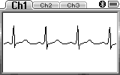
Holter Systems
Recording duration: 24, 48, 72 hours, 1 week
Recording rate: 128, 256, 512, 1024 Hz
ADC resolution: 16 bit
Dynamic range: +/- 20 mV
CMRR: 120dB
Powered by only 1 AAA battery

Slide 6
Holter Systems
Recording duration: 24, 48, 72 hours, 1 week
Recording rate: 128, 256, 512, 1024 Hz
ADC resolution: 16 bit
Dynamic range: +/- 20 mV
CMRR: 120dB
Powered by only 1 AAA battery

Slide 7
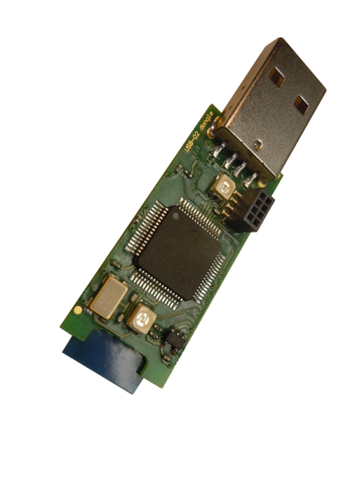
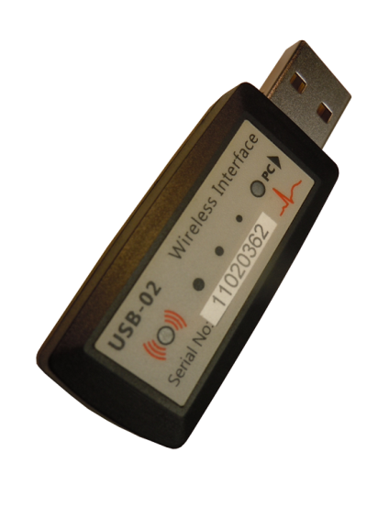
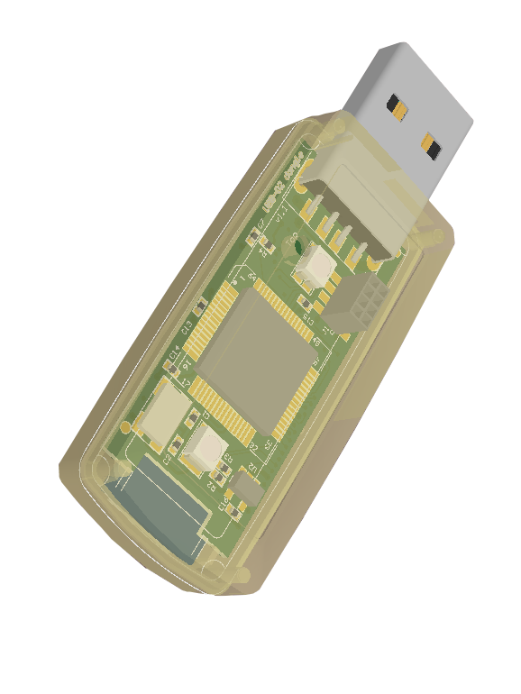
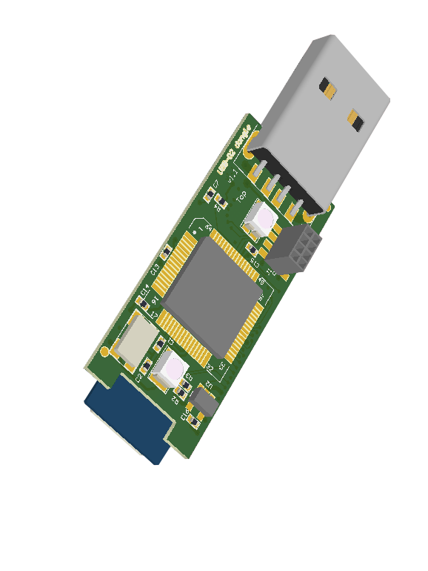
Holter Systems
New USB-02 Wireless Interface
Wireless Bluetooth® connection
Convenient, reliable, easy to use
Simple, quick pairing
Fully compatible with Windows® XP, Vista, and 7 (32/64 bit)

Slide 8
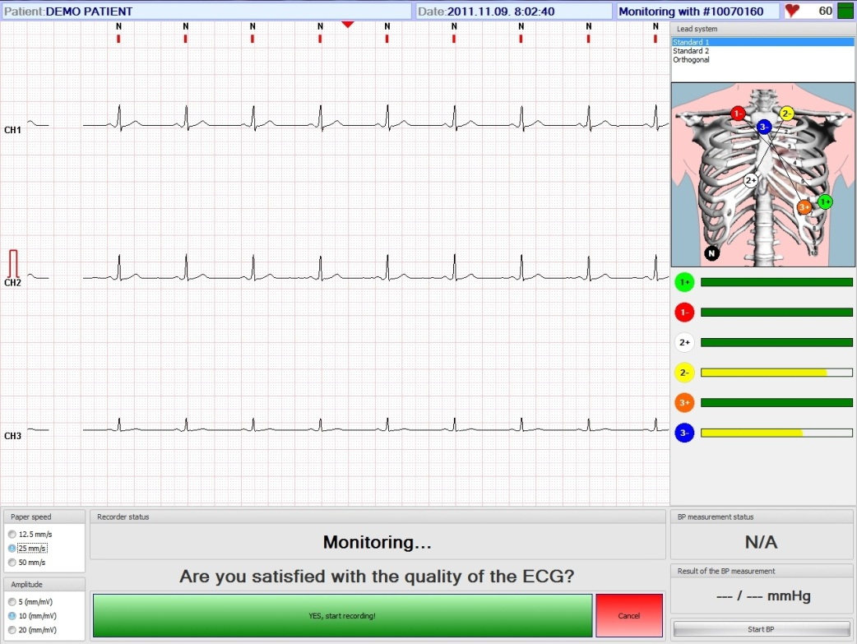
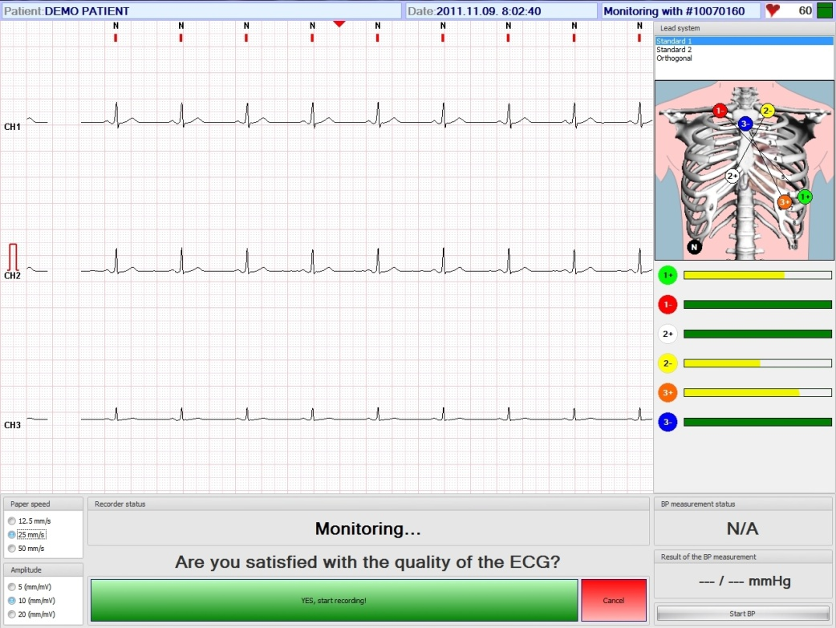
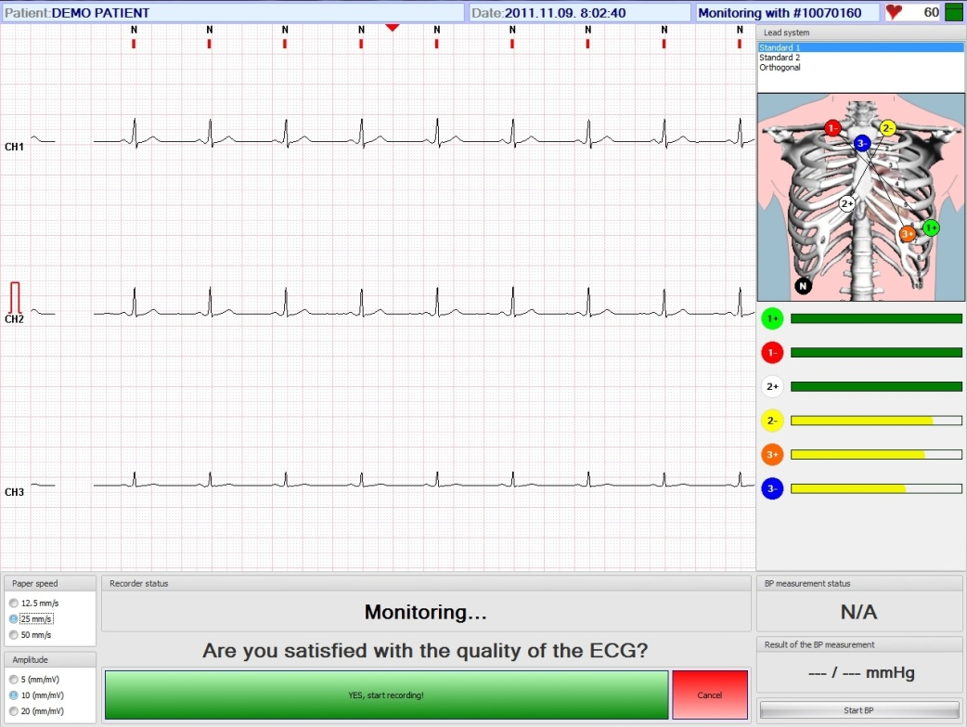
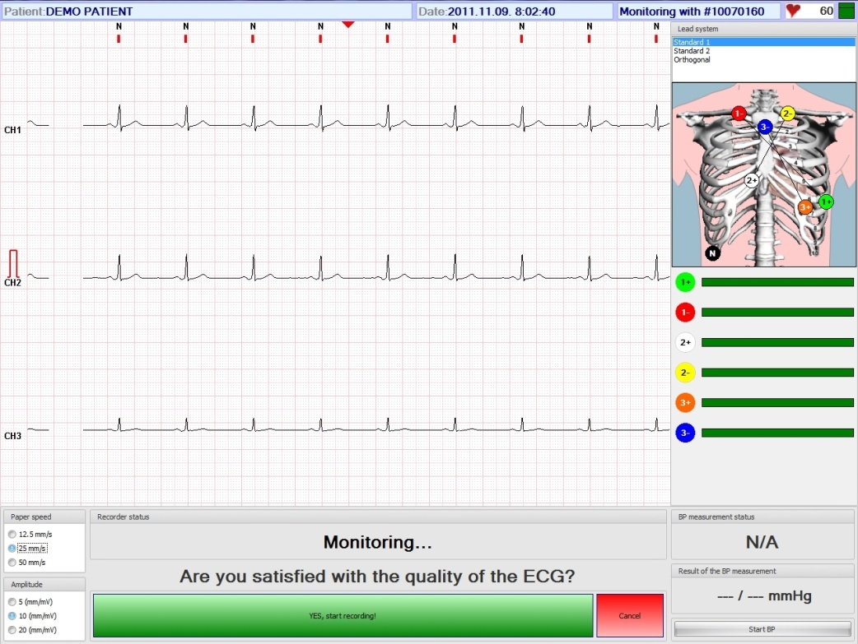
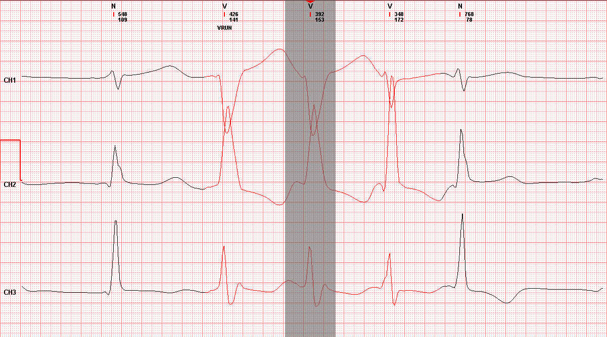
Holter Systems
Good quality ECG signal
Electrode connection check before recording
Effective filtering
method

Slide 9
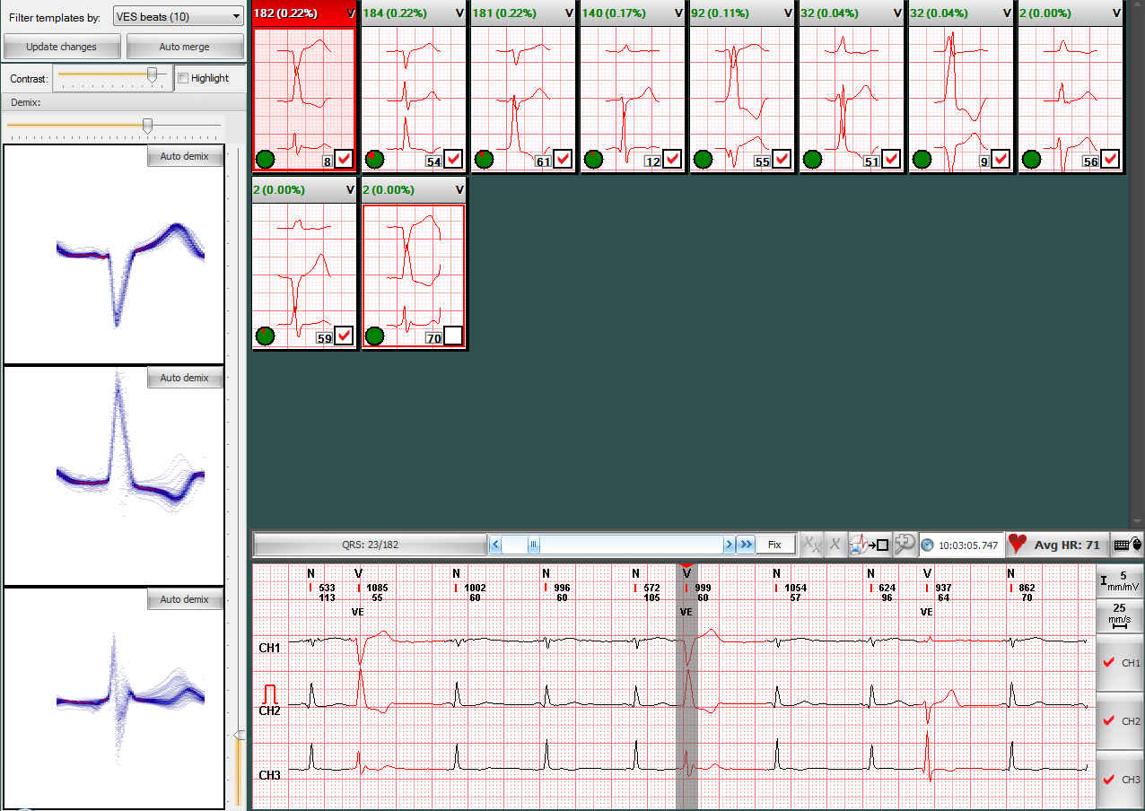
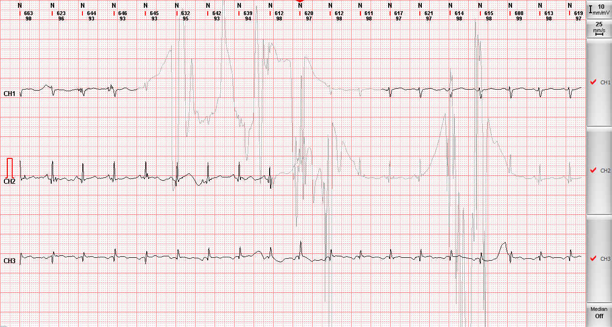
Holter Systems
Fast and reliable analysis with editing possibilities
Channel-selective QRS detection
Automatic noise detection
Precise QRS detection
QRS template classification

Slide 10
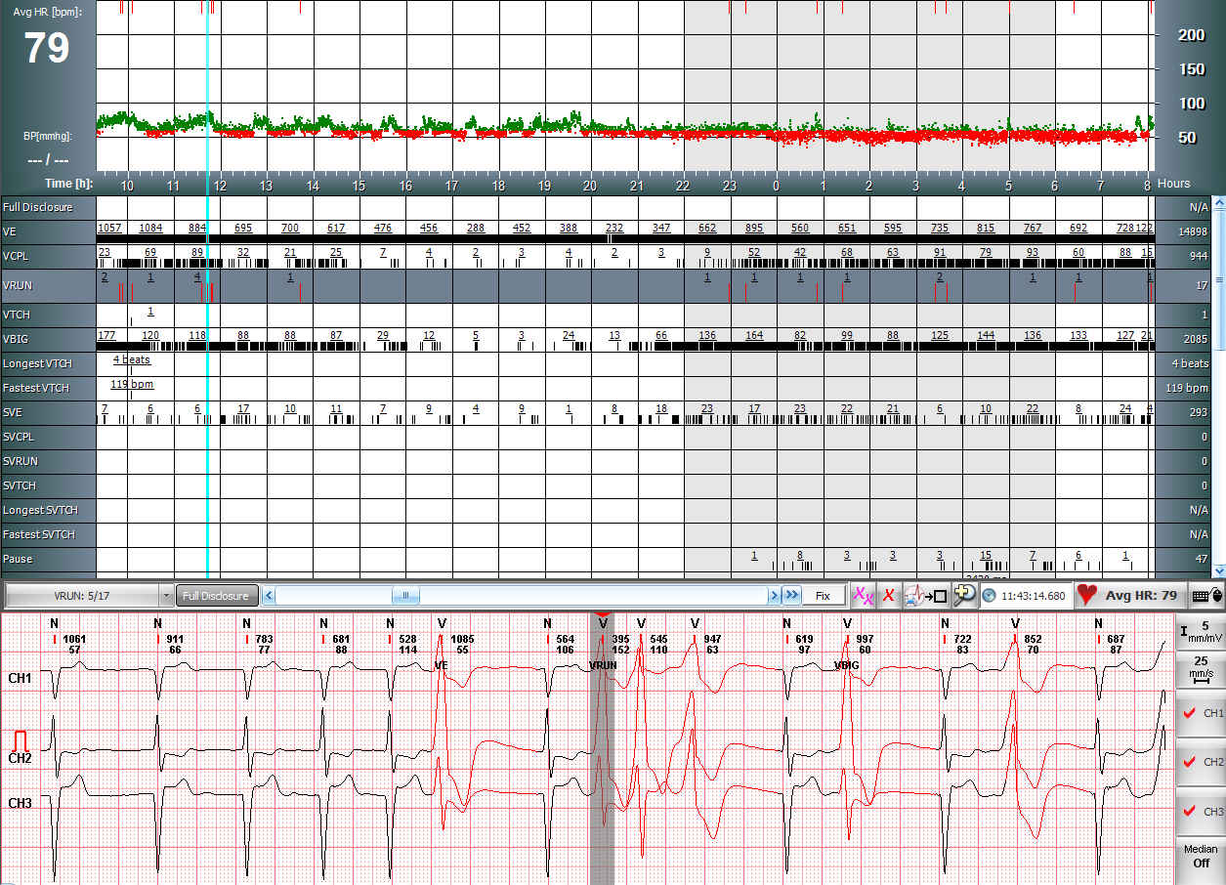
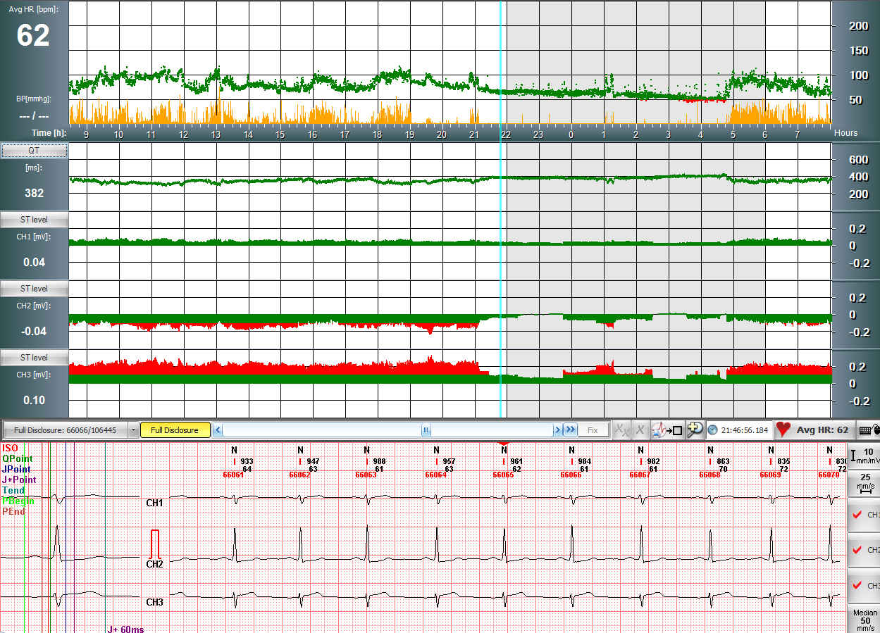
Holter Systems
Several types of computed parameters
Arrhythmia analysis
HR and Patient
motion graphs
QT, QTc graphs
ST level and slope
SAECG

Slide 11
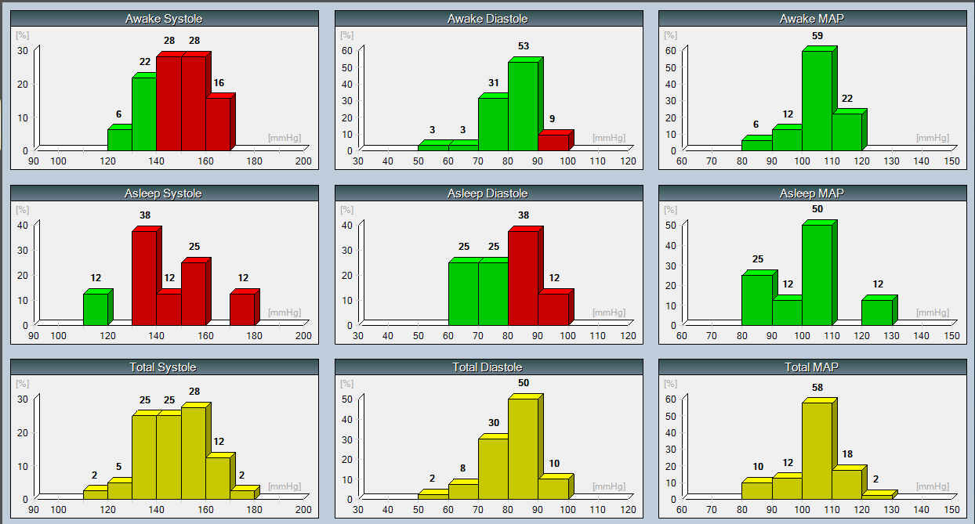
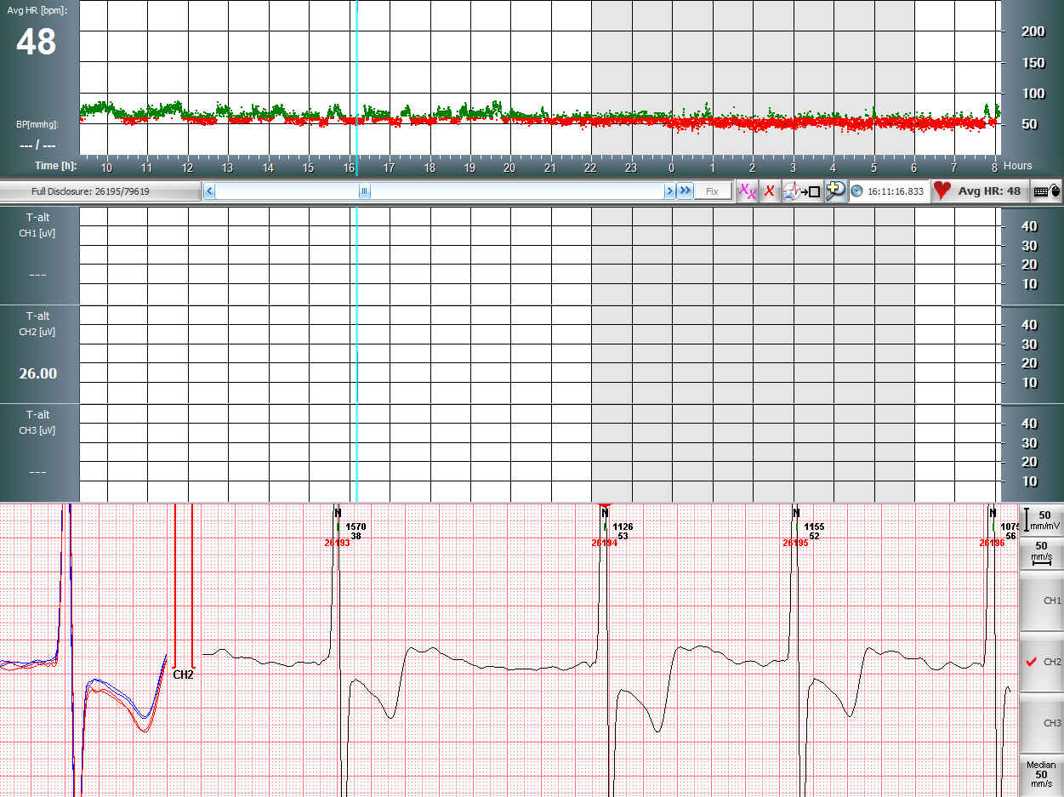
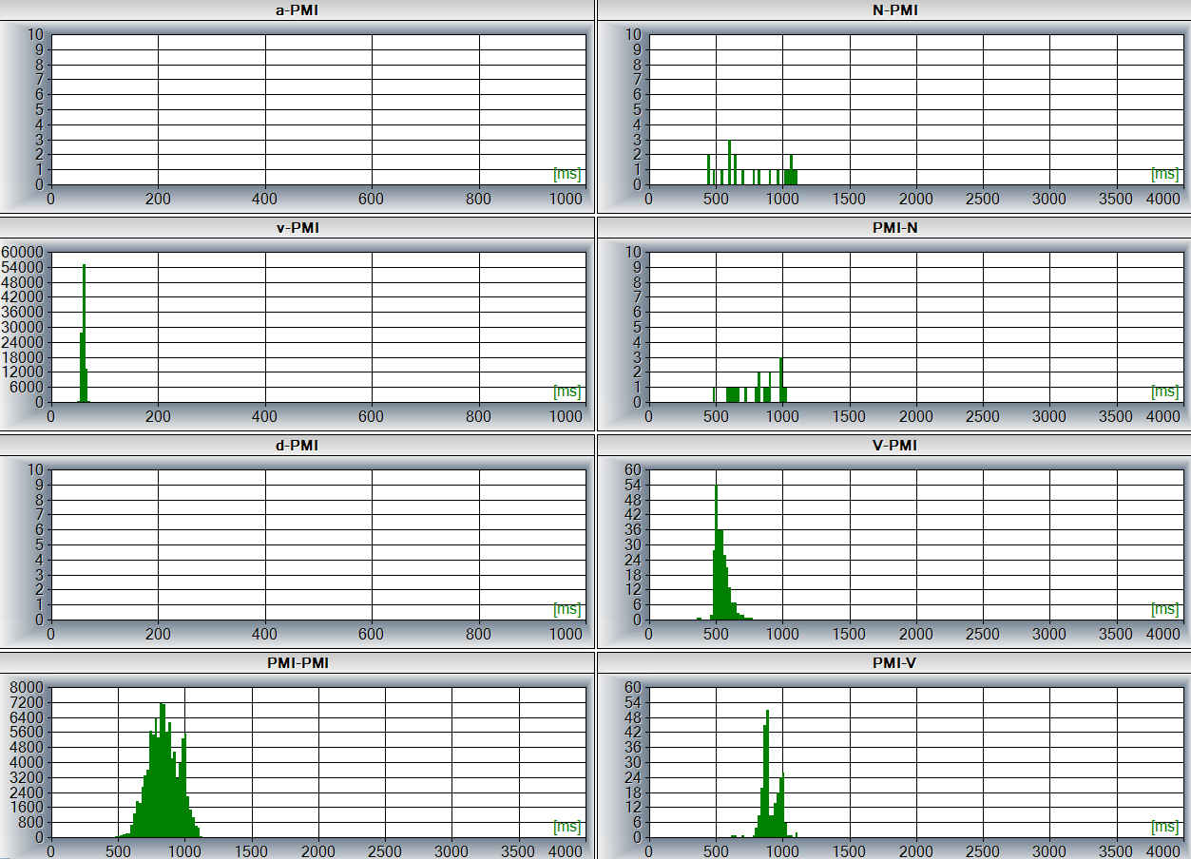
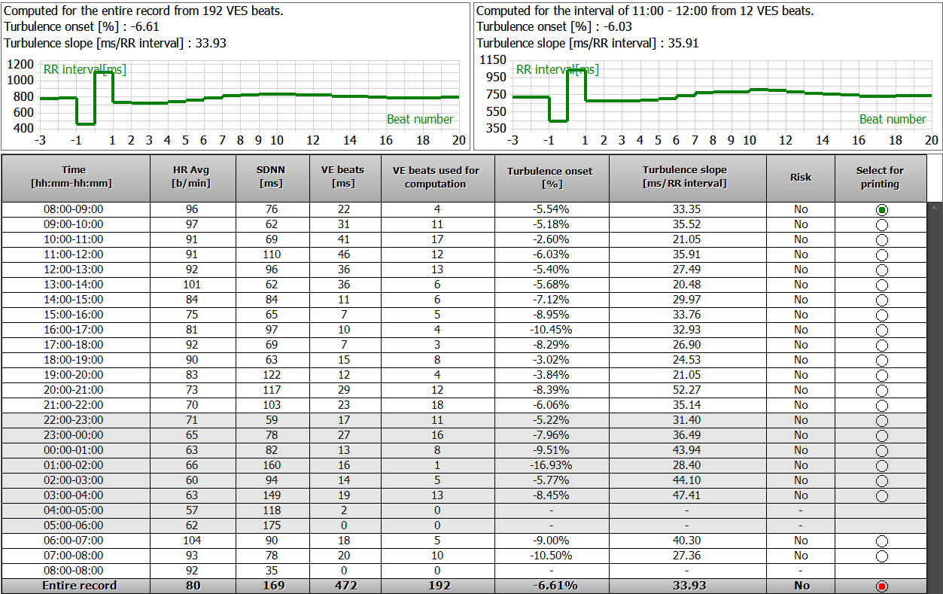
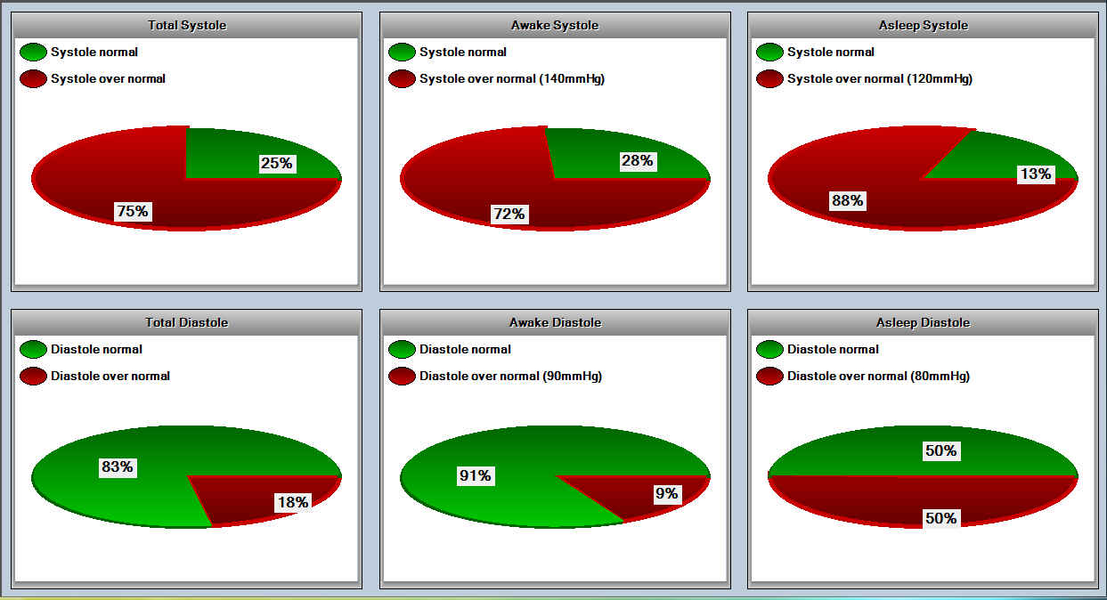
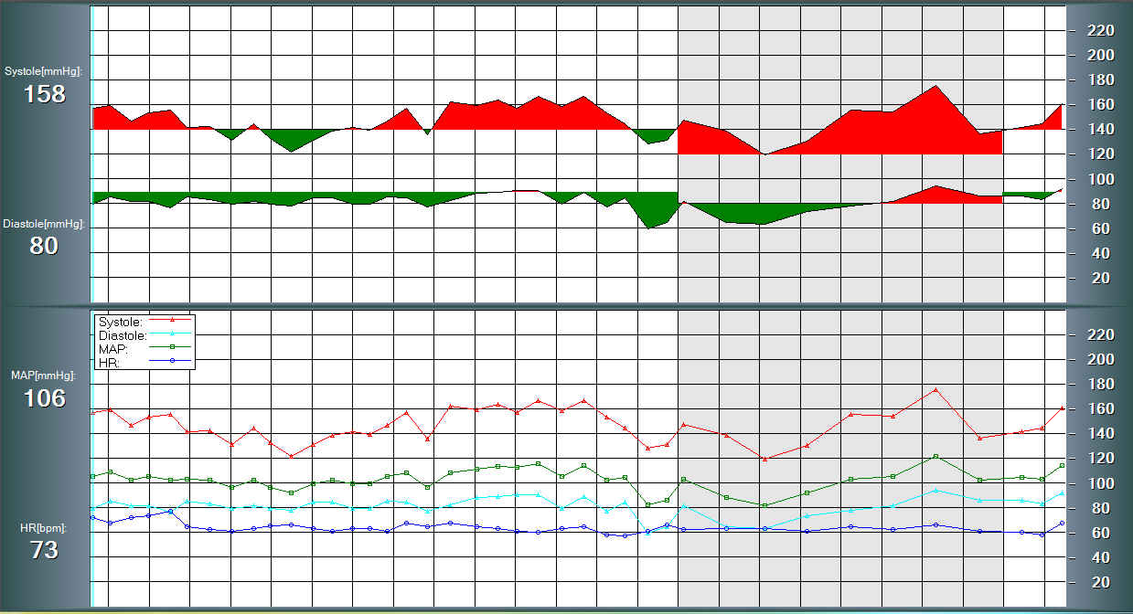
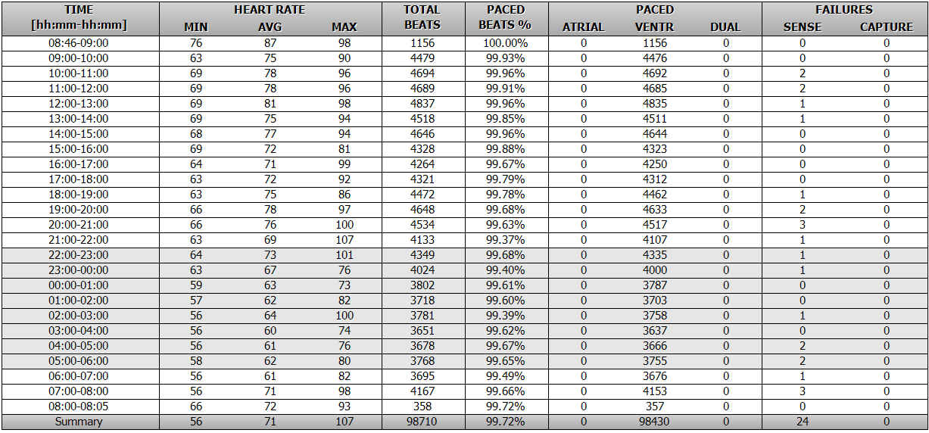
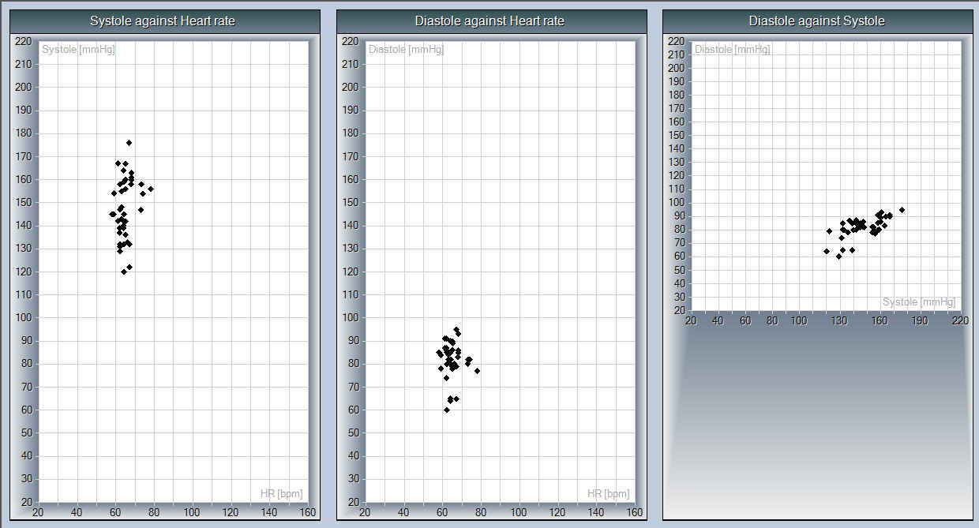
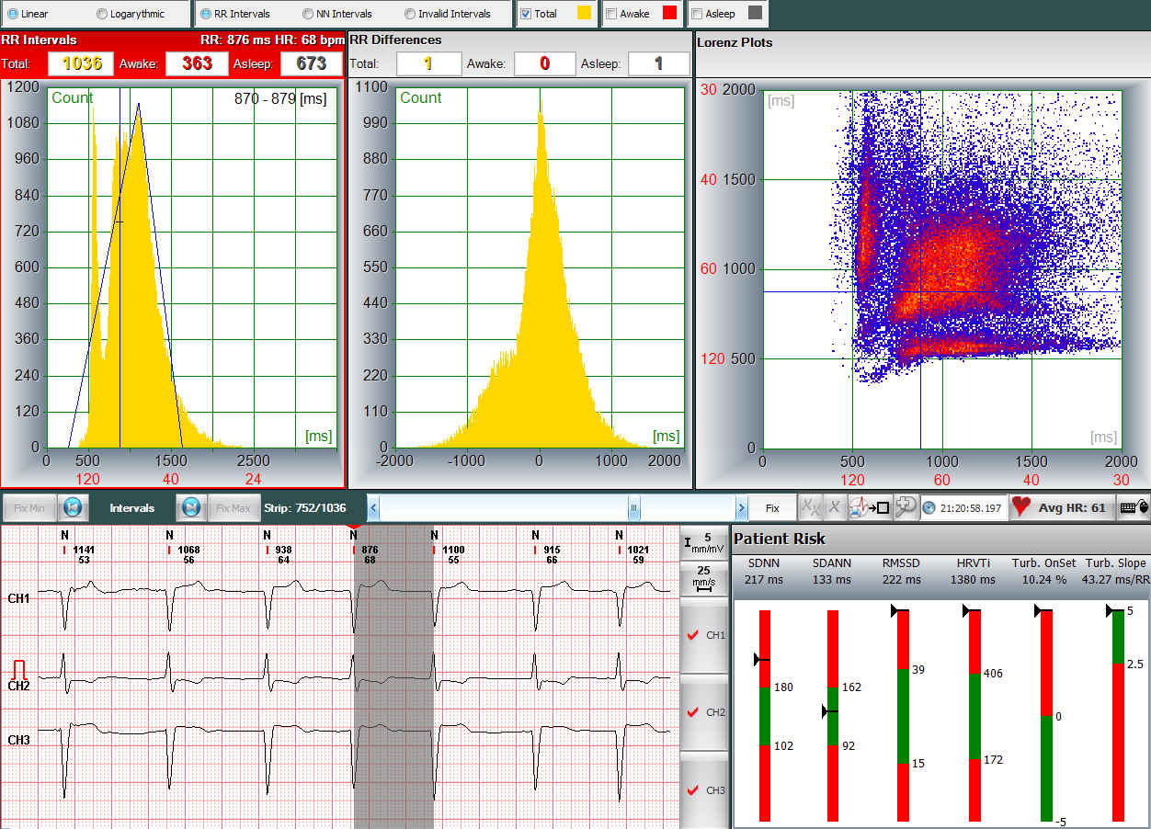
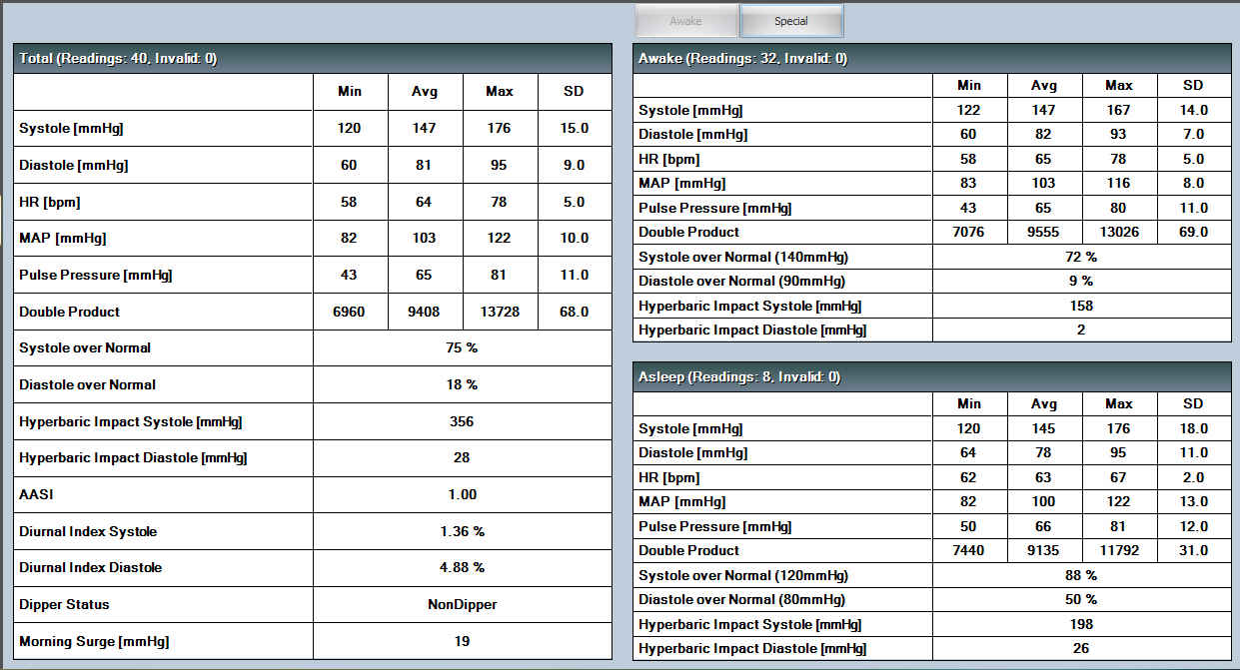
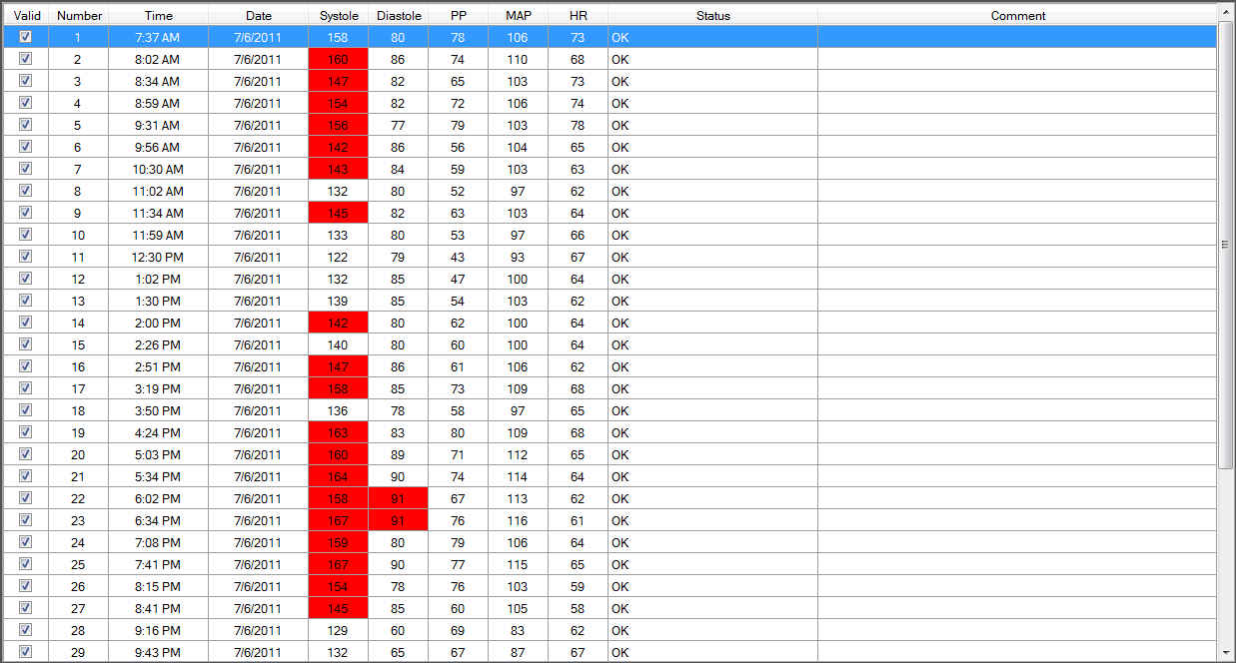
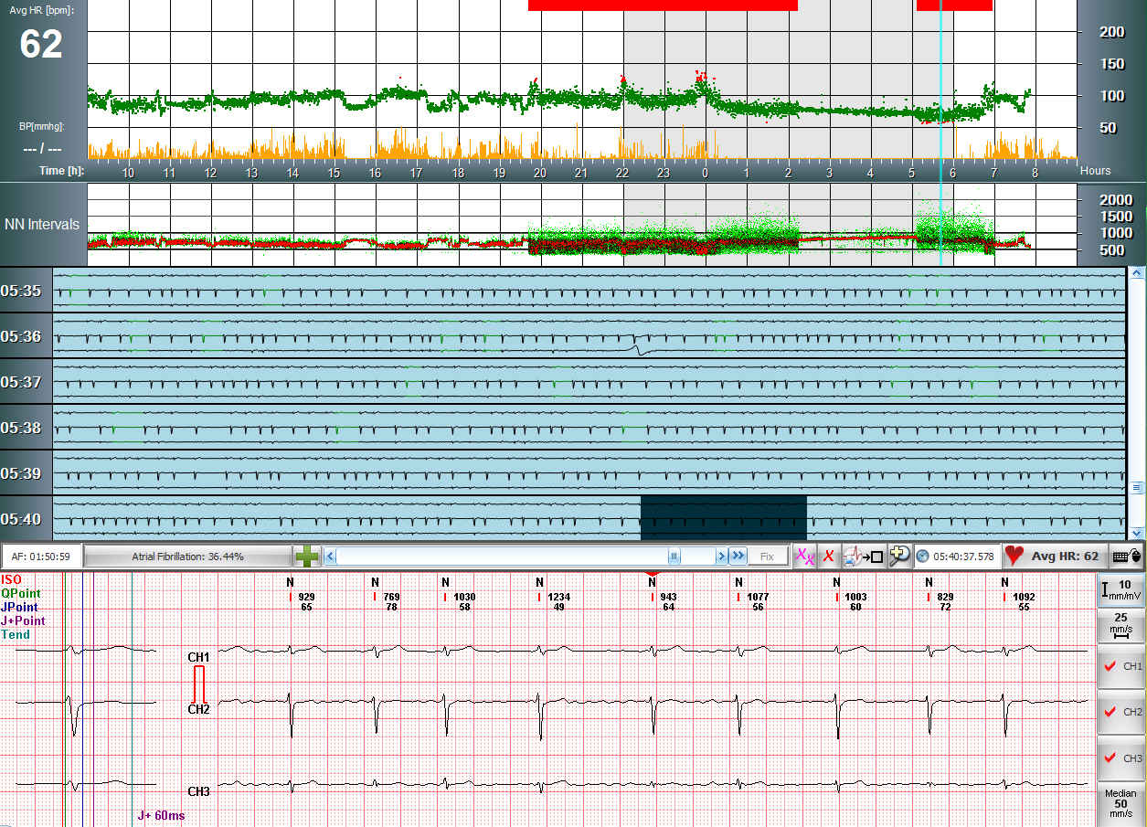
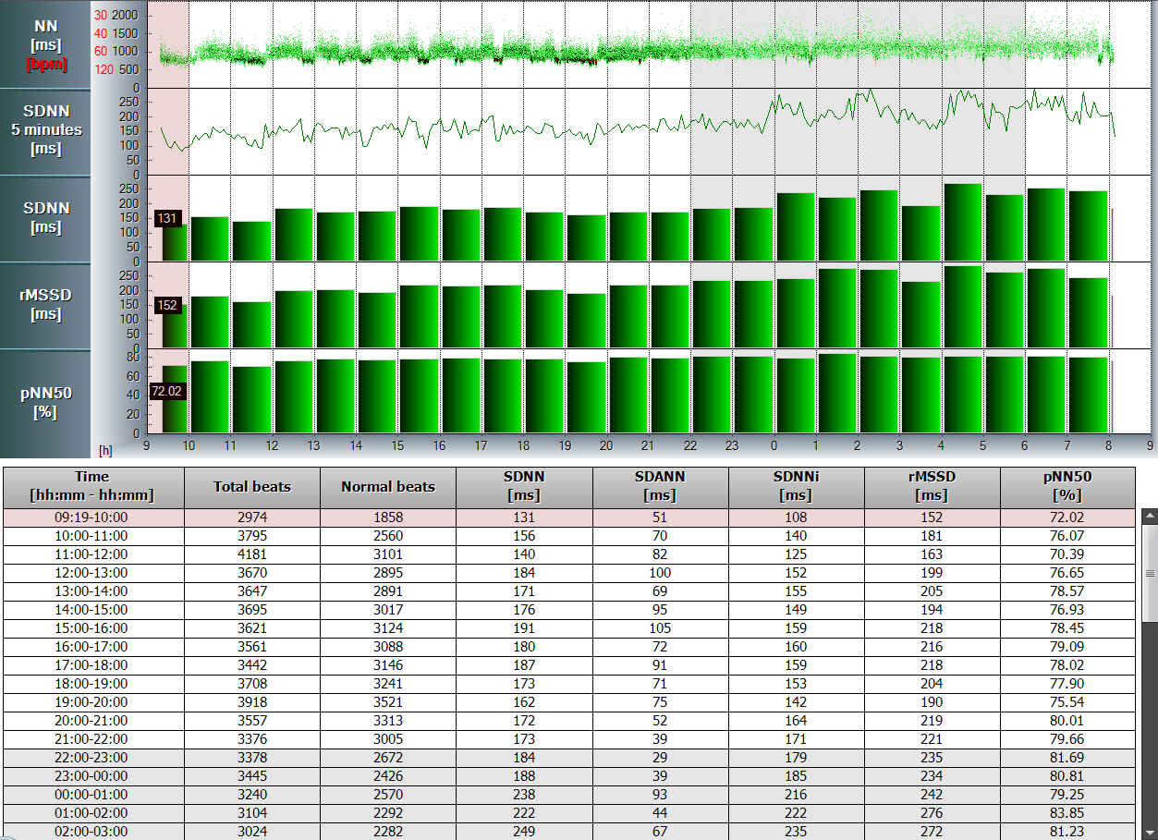
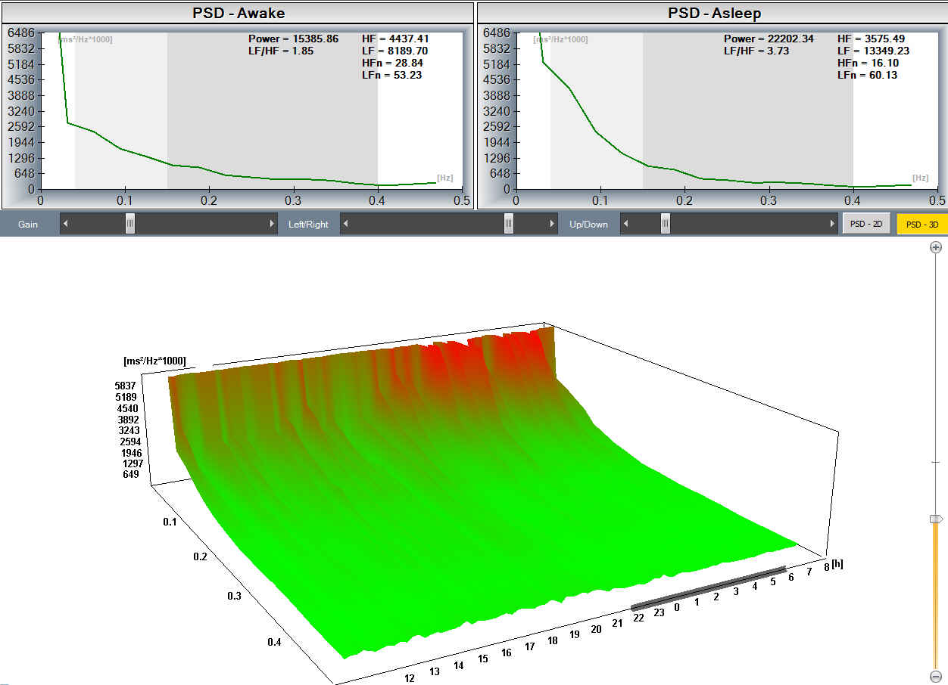
Holter Systems
Several types of computed parameters
HRV time and frequency
Atrial fibrillation
AF
AF
Heart rate turbulence
Microvolt T alternans
Pacemaker analysis
Blood pressure graphs

Slide 12
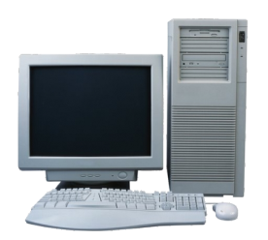
Holter Systems
Informatics support
SERVER
FTP Server
Record
Record
Network application
DICOM
Internet
Record, report forwarding
GDT
Internet
MFER
Interfaces
Internet
Record
Record
Email Server
Internet
CLIENT
CLIENT
SERVER
CLIENT
CLIENT

Slide 13
PC Based ECG Systems
Holter Systems
Rest and Stress Systems
NetECG Systems

Slide 14
Rest and Stress Systems
Wireless Resting And/Or Stress Test Device
Sampling rate: 1000 Hz
12 channels resting and/or stress ECG
A/D resolution: 16 bit
Built-in Blood Pressure Monitor
Frequency response: 0.05 … 150 Hz
EC-12R, EC-12R/S, EC-12S
Wireless Bluetooth® connection
Dynamic range: +/-20 mV
Low Power Consumption
CMRR: 120 dB
Small size, compact build-up
Powered by 2 AA batteries

Slide 15
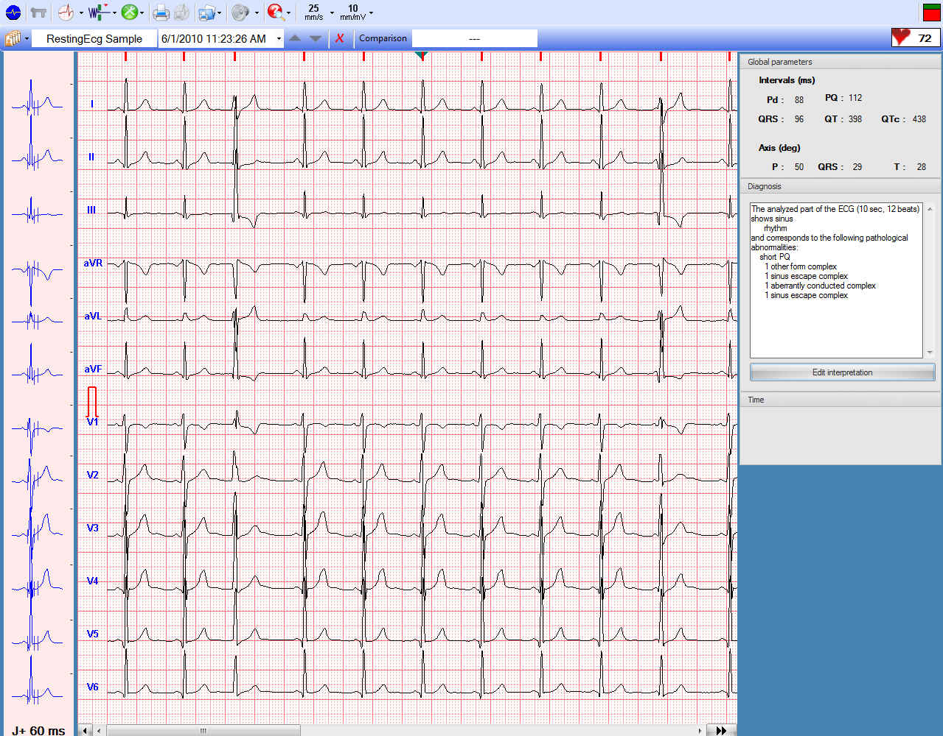
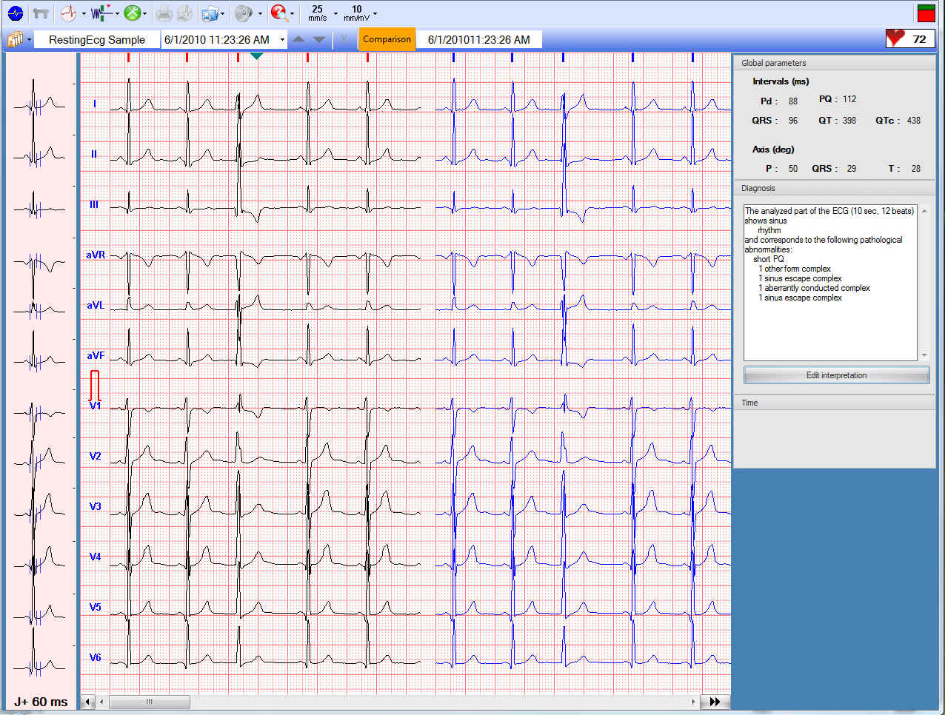
Rest and Stress Systems
Resting ECG
5, 10, 20s and long
record (up to 7 hrs)
Built-in diagnostic
system
Comparison of ECG
records

Slide 16
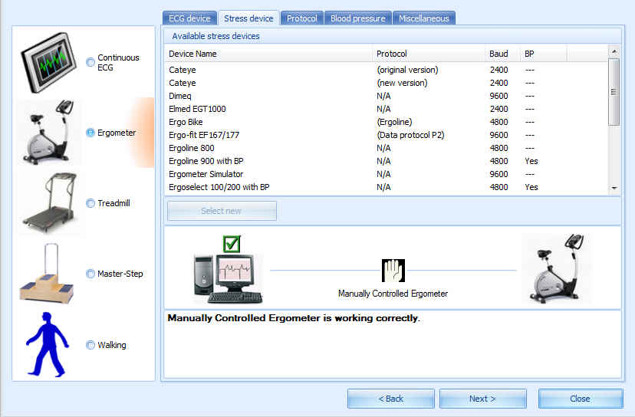
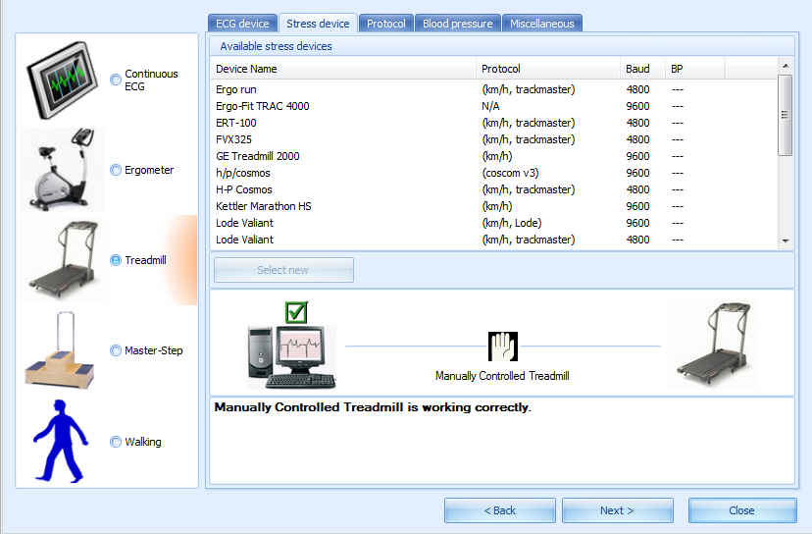
Rest and Stress Systems
Large ergometer and treadmill database
17 ergometer, 18
treadmill protocols
MasterStep protocol
Walking protocol

Slide 17
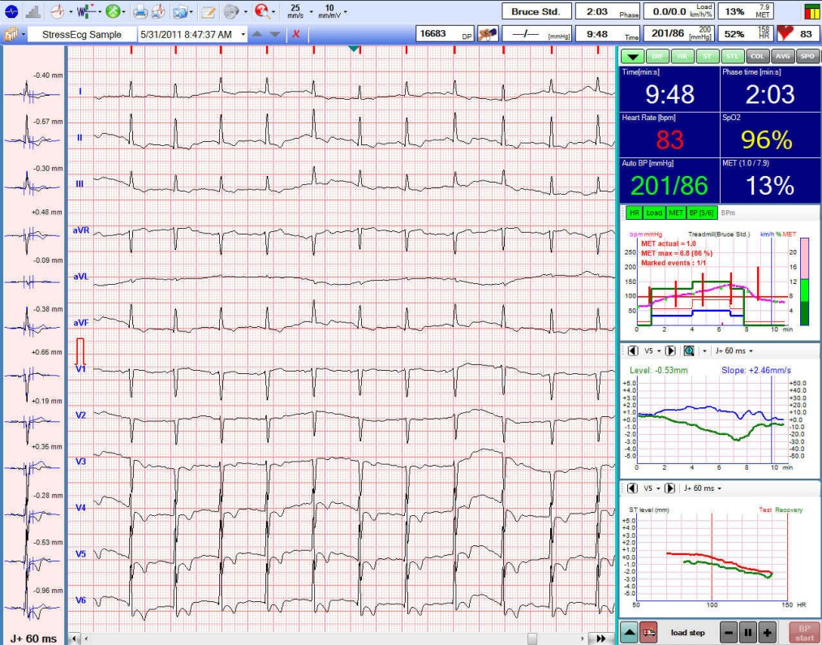
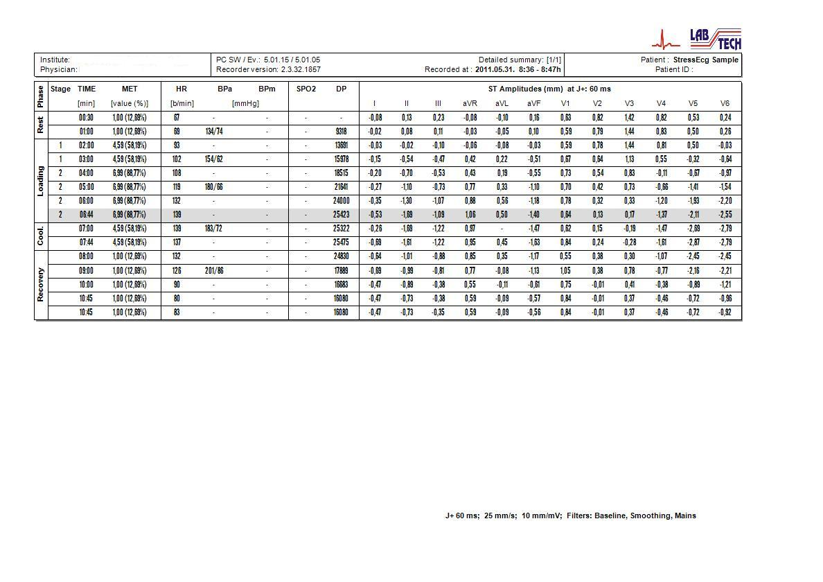
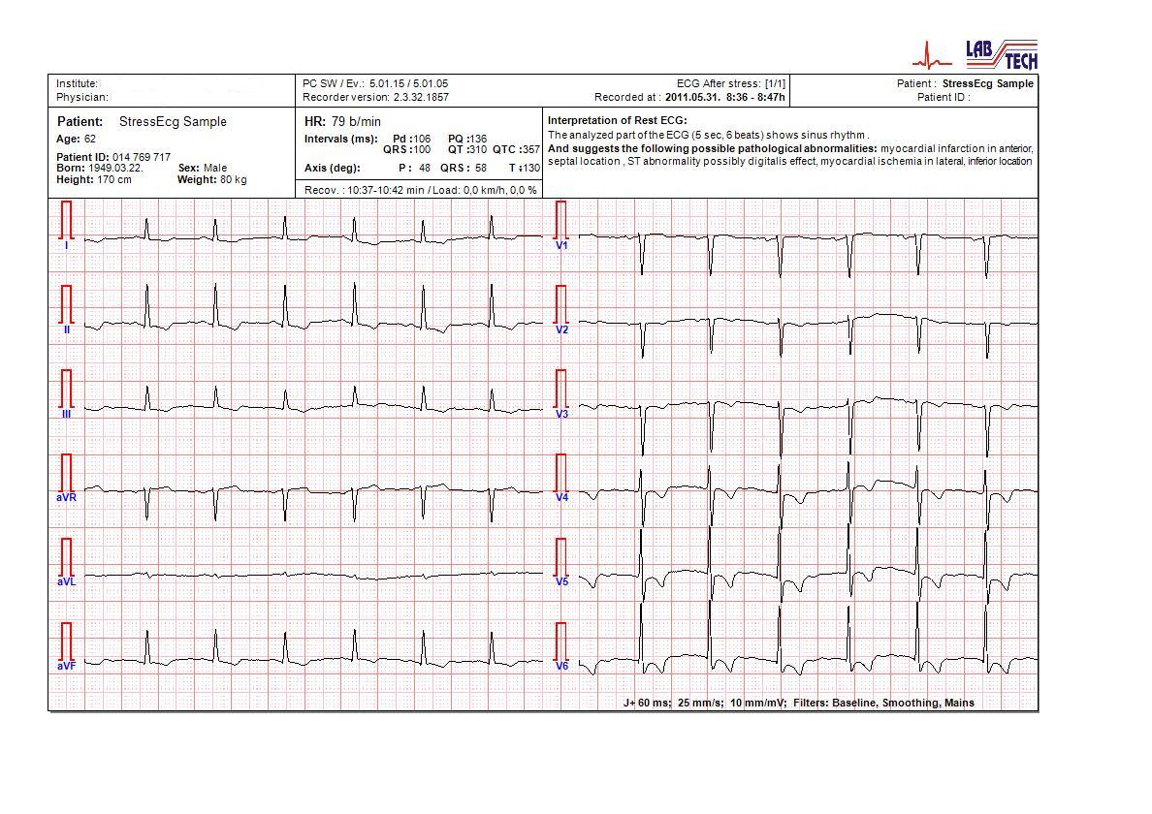
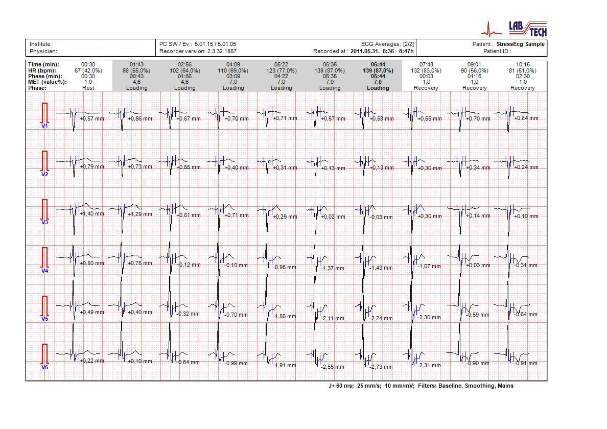
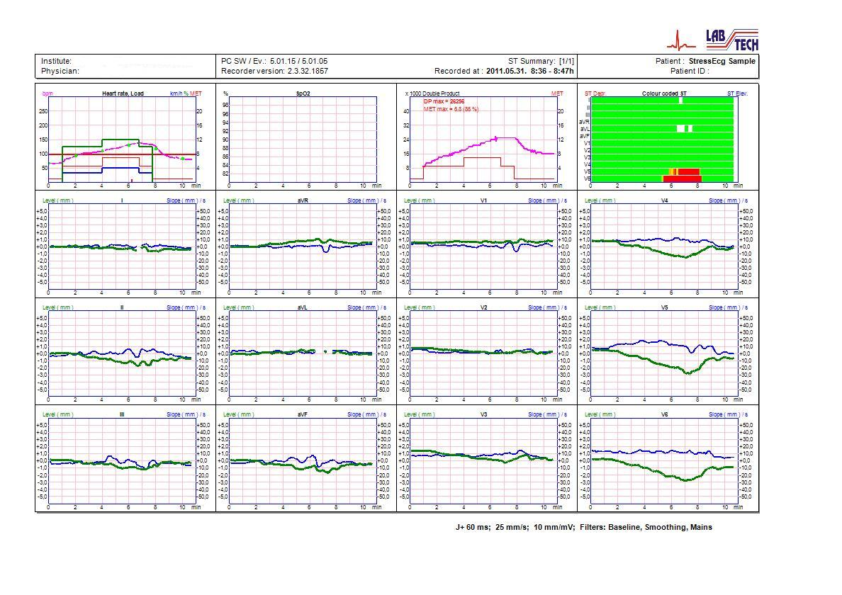
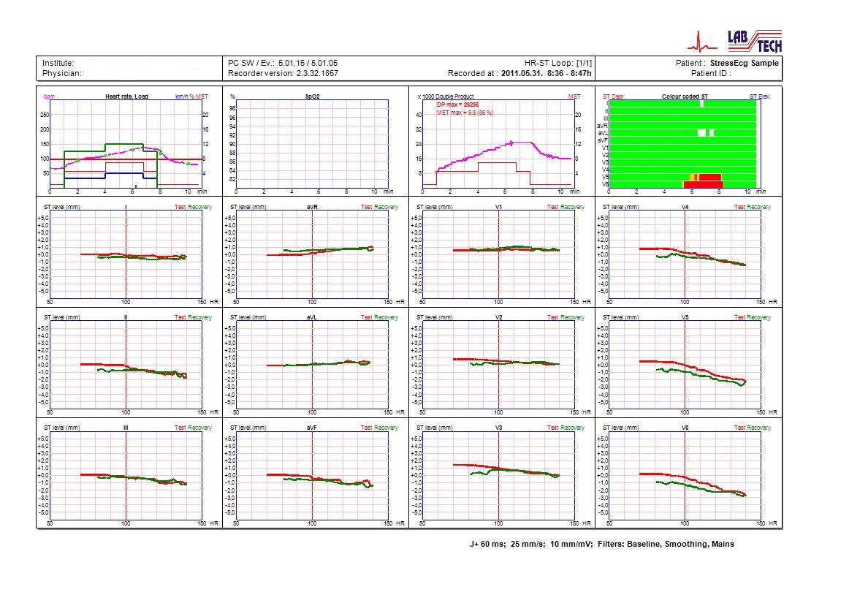
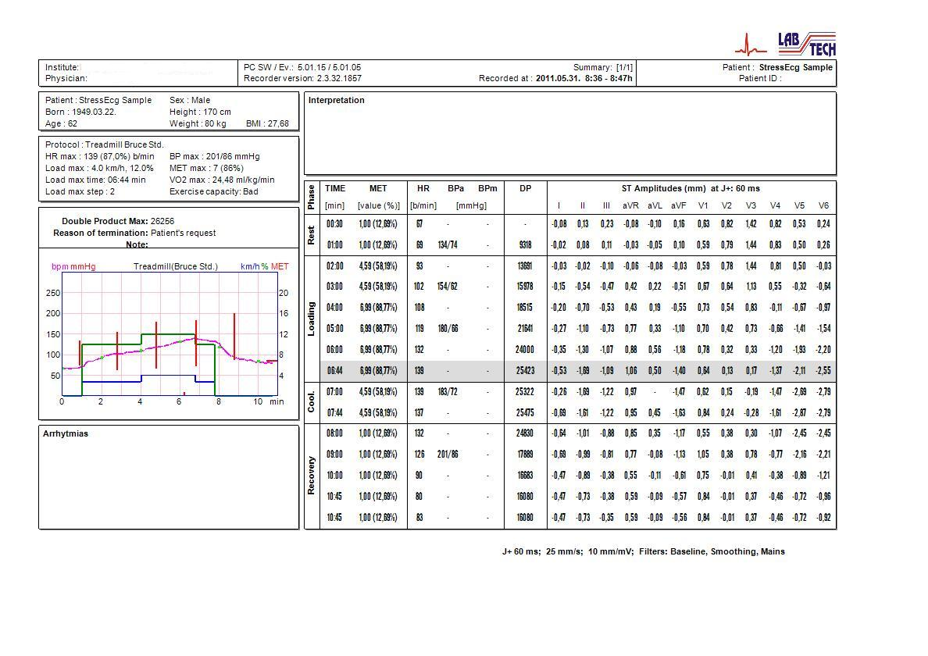
Rest and Stress Systems
Several types of computed parameters
HR, BP
Double product, MET
SAECG
ST level and slope, HR-
ST loop
Several kinds of
printable reports

Slide 18
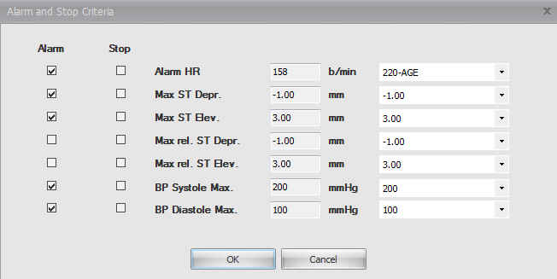
Rest and Stress Systems
Alarm and stop criterias
Heart rate
ST level
BP systole
BP diastole

Slide 19
Rest and Stress Systems
Informatics support
SERVER
FTP Server
Record
Record
Network application
DICOM
Internet
Record, report forwarding
GDT
Internet
MFER
Interfaces
Internet
Record
Record
Email Server
Internet
CLIENT
CLIENT
SERVER
CLIENT
CLIENT

Slide 20
PC Based ECG Systems
Holter Systems
Rest and Stress Systems
NetECG Systems

Slide 21
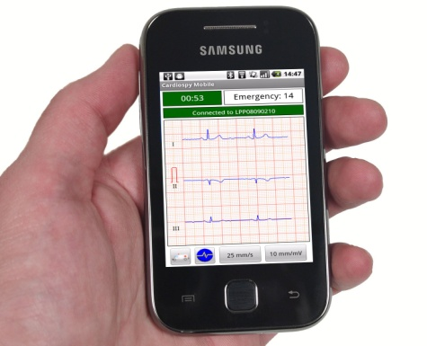
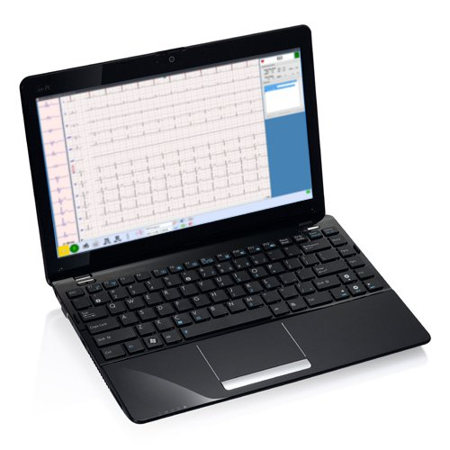
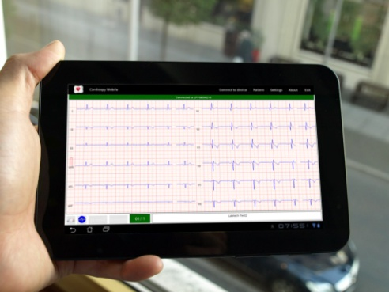
NetECG Systems
Platform
Android TM
Windows
Android is a trademark of Google Inc.

Slide 22
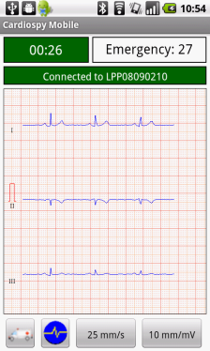
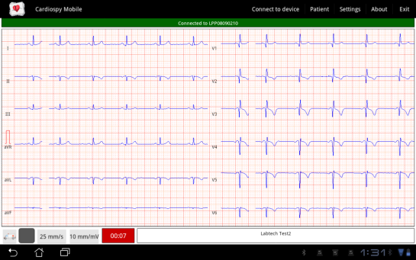
NetECG Systems
Software characteristics
Real-time ECG display
12-channel resting ECG
Portrait and landscape display mode
Bluetooth connection with the ECG recorder
Send reports in JPG or MFER format via email
Save records to SD card then syncronise
to Cardiospy software via USB cable
Send records to Cardiospy's “cloud” application

Slide 23
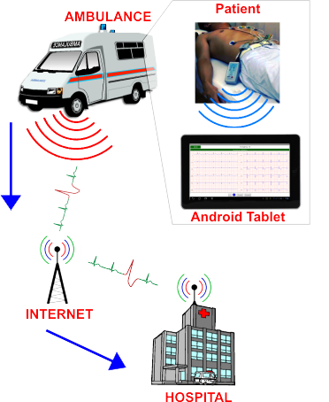
NetECG Systems
The product is ideal to use in an emergency car, because:
„The patient receives the appropriate treatment sooner as patient registration takes less time.”
„The tablet is easy to use, it is small and mobile.”
„It performs a preliminary analysis of the patient on his way to the hospital.”
„Records are easy to upload to an emergency centre where they are immediately evaluated by Cardiospy’s „cloud” application.”
„Wireless technology eliminates the inconvenience of using cables.”
„It immediately provides feedback on the patient’s condition.”

